Slide 1
DPZ Meeting

Slide 2
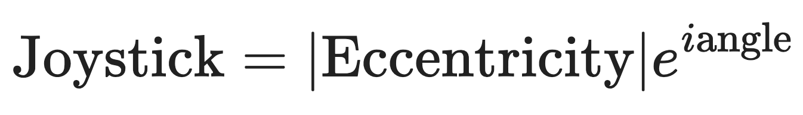
What’s new ?
Complex notation (I added the eccentricity):
Kernel profile for each agent (one kernel per coherence)
divided the data into training set and test set for each agent and per coherence
Averaged kernels over agents
Lasso regularisation of the kernels

Slide 3
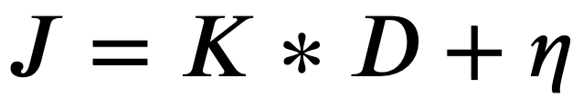
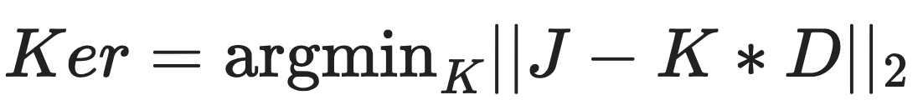
Basic kernel

Slide 4
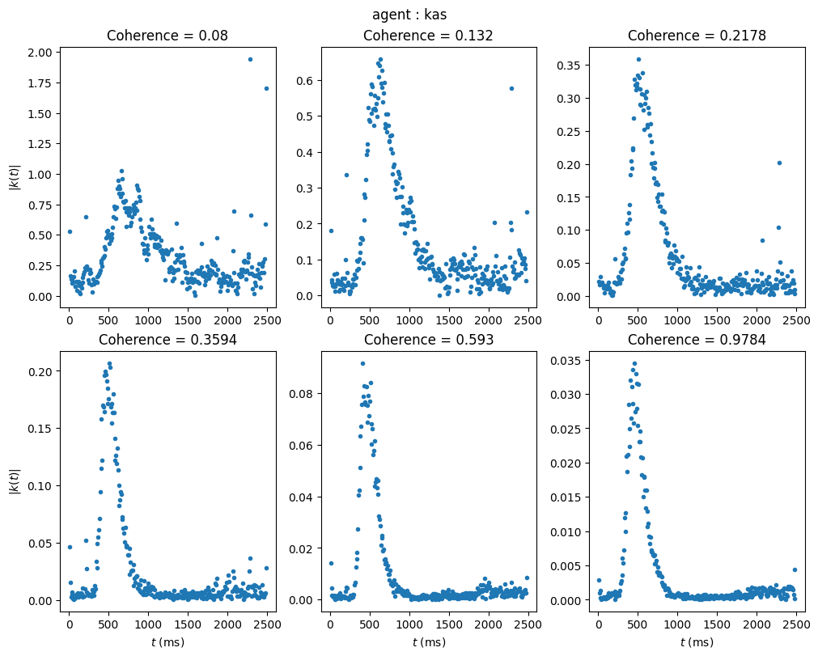
Kernel Profile of one agent

Slide 5
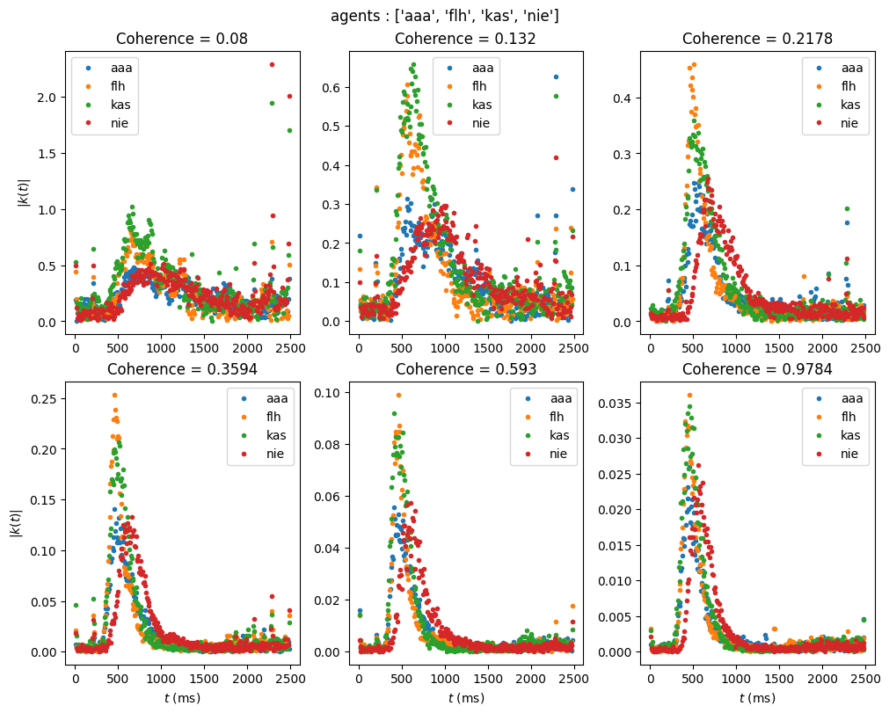
Kernel profile for 4 agents

Slide 6
Kernel profile for 4 agents

Slide 7
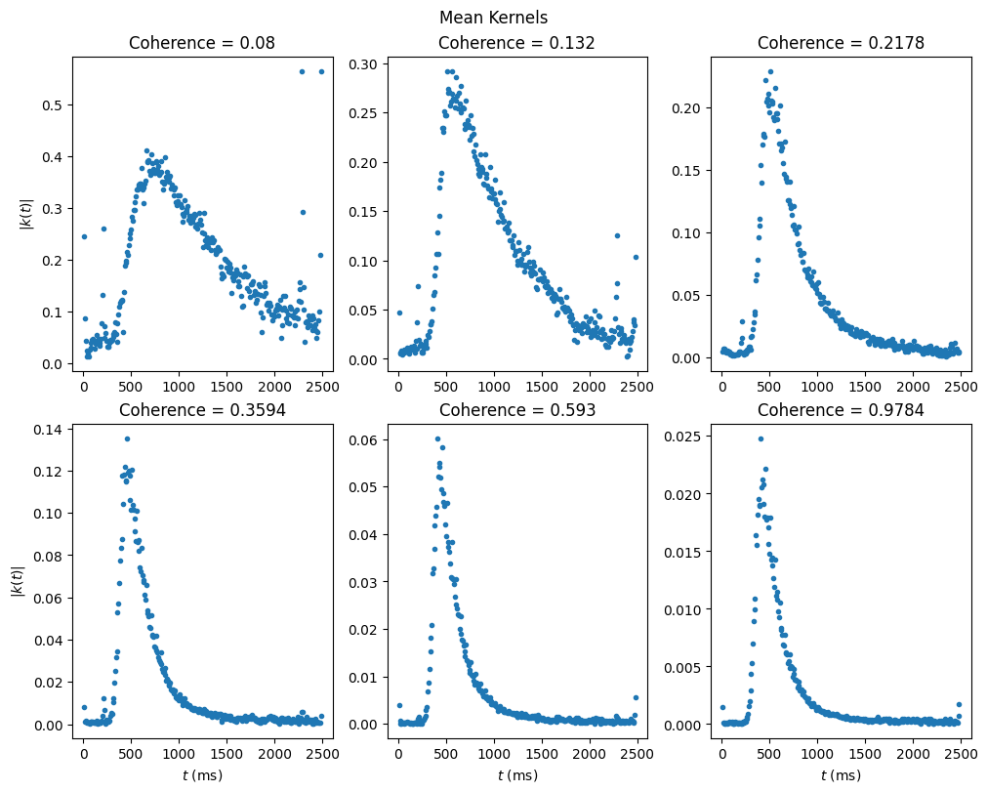
Mean kernel Profile

Slide 8
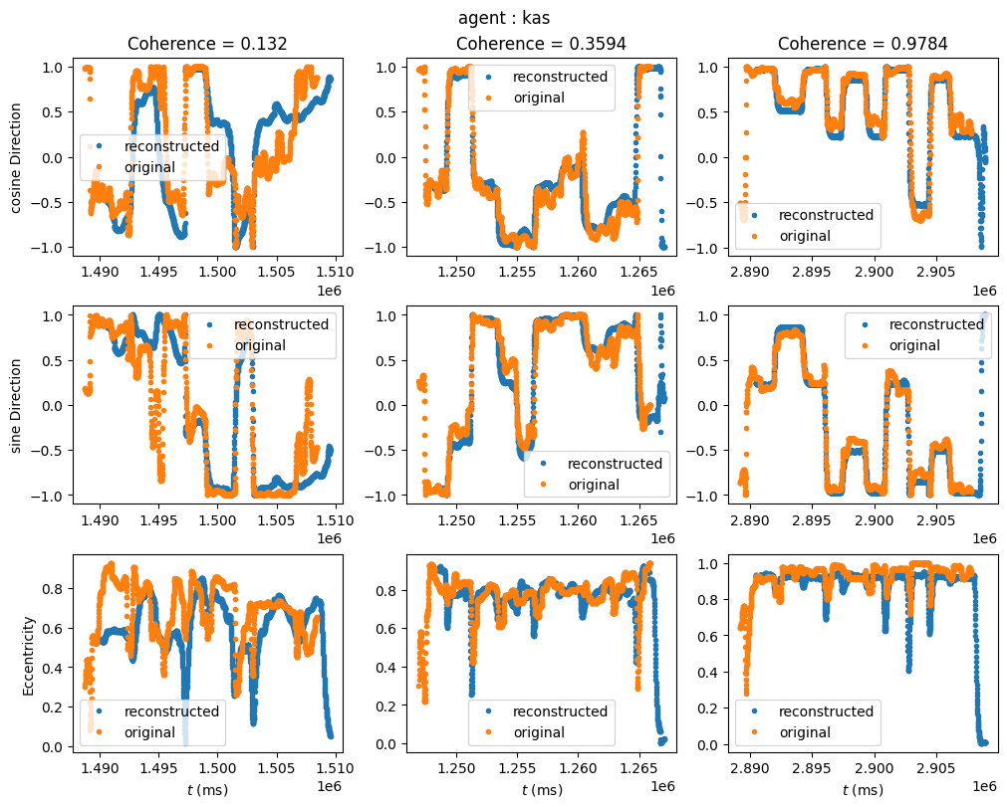
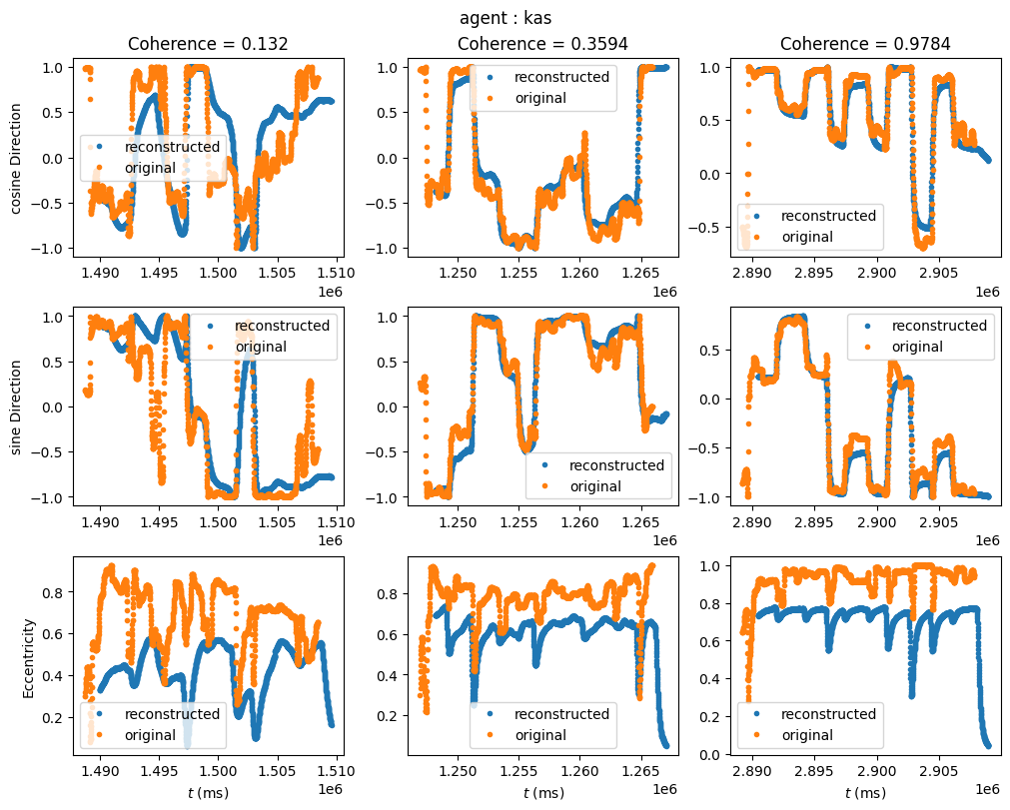
Joystick reconstruction (Training set)
Personal kernel
Mean kernel

Slide 9
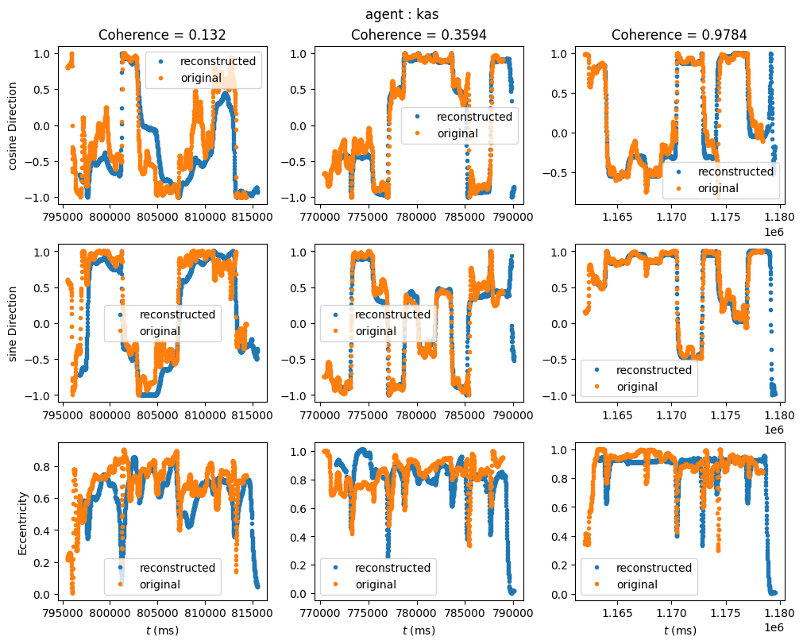
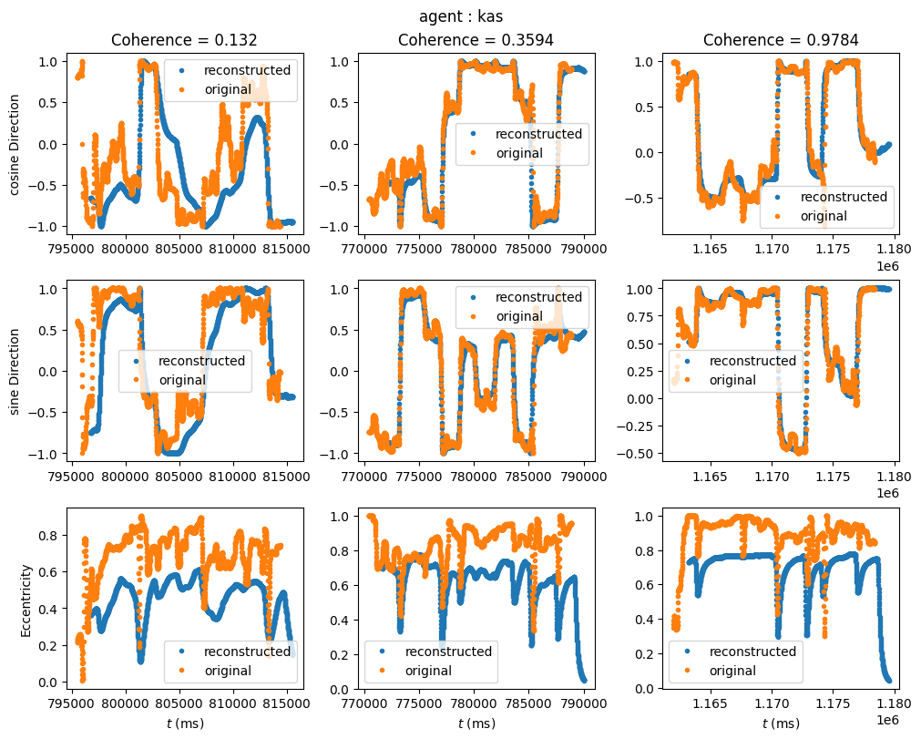
Joystick reconstruction (Test set)
agent specific kernel
Mean kernel

Slide 10
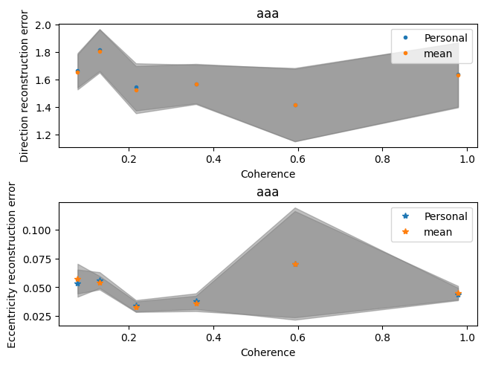
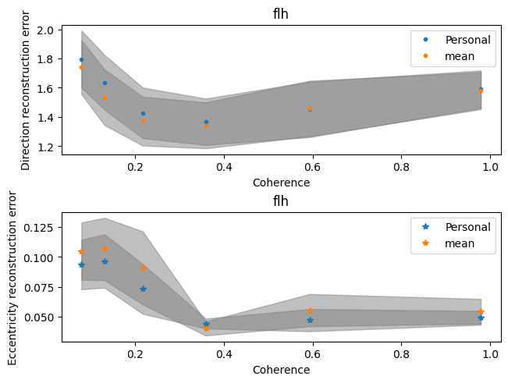
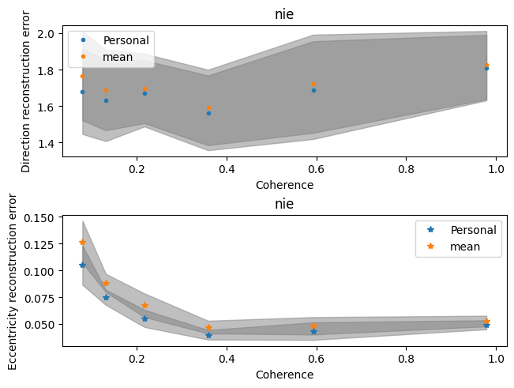
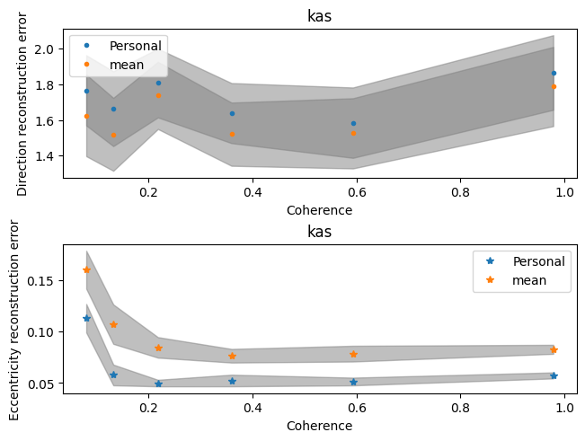
Reconstruction error: agent specific vs mean kernel

Slide 11
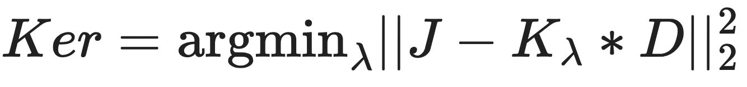
L1 regularized kernel (LASSO)

Slide 12
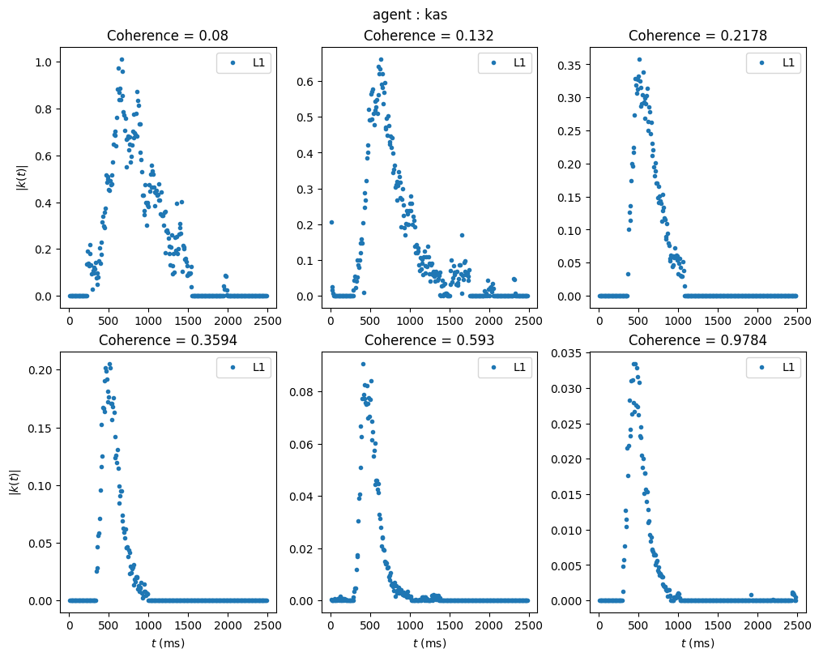
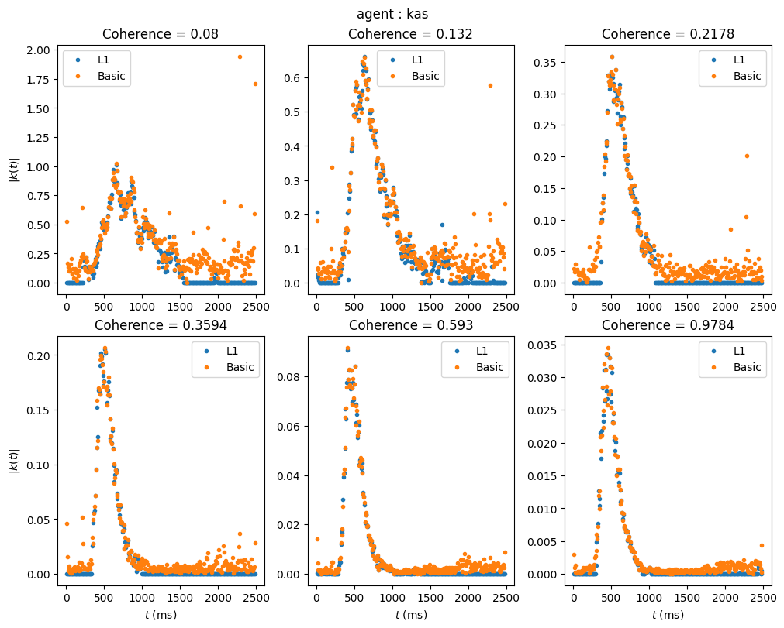
Kernel Profile of one agent

Slide 13
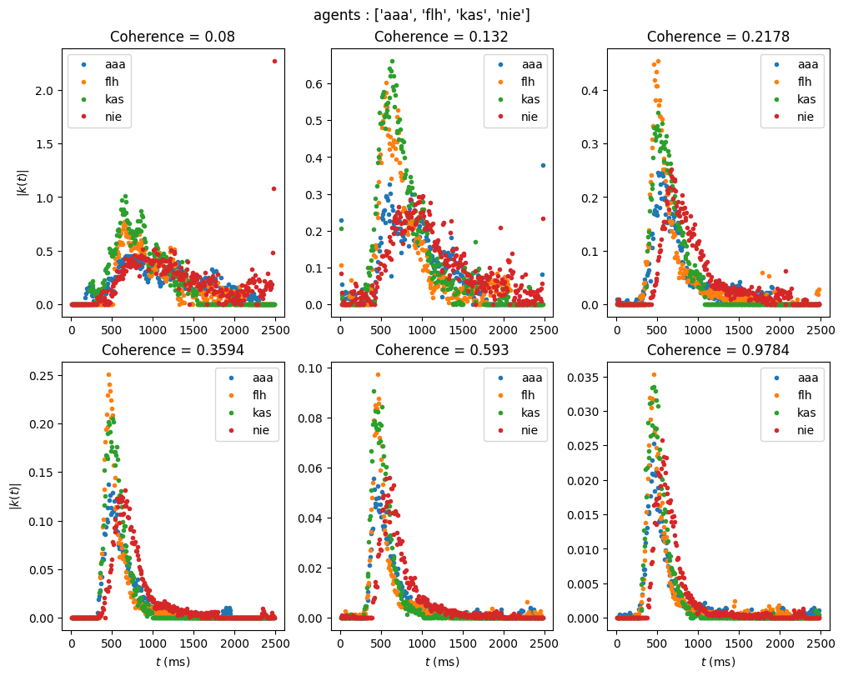
L1 kernel profile for 4 agents

Slide 14
Kernel profile for 4 agents

Slide 15
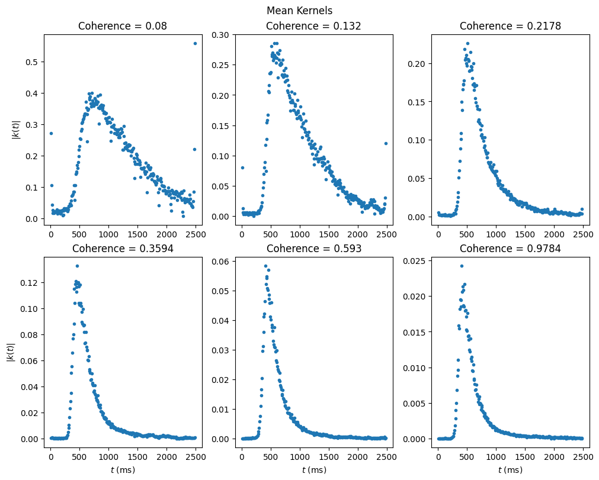
L1 mean kernel Profile

Slide 16
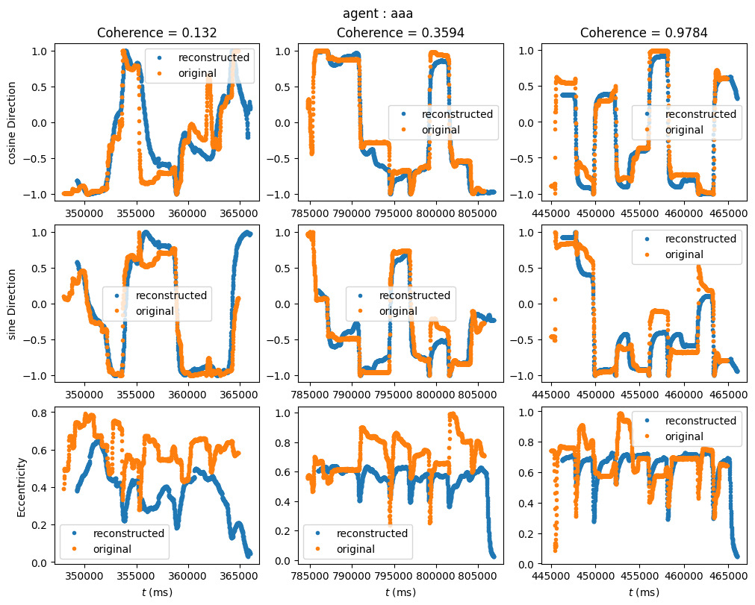
Joystick reconstruction (Training set)

Slide 17
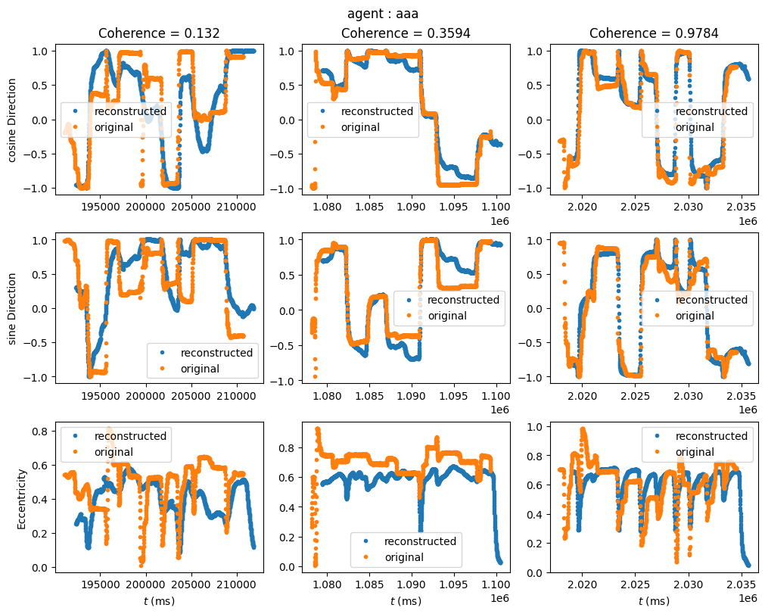
Joystick reconstruction (Test set)

Slide 18
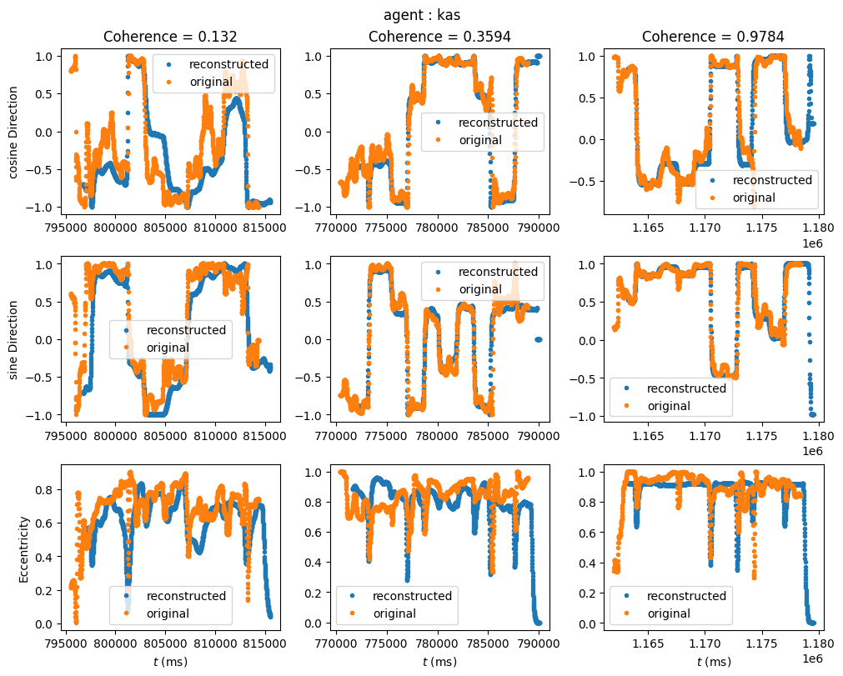

Joystick reconstruction (Test set)
Agent specific kernel
Mean kernel

Slide 19
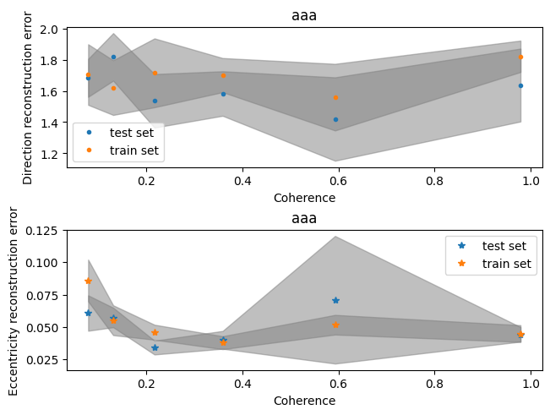
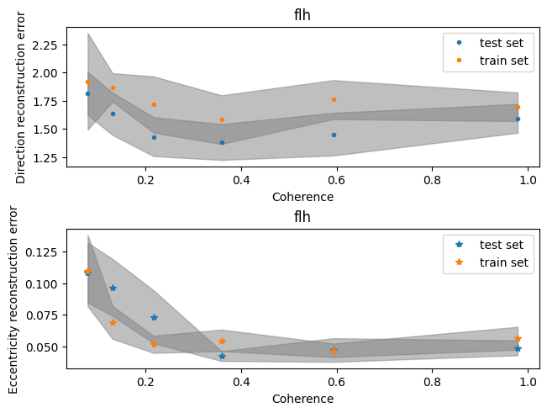
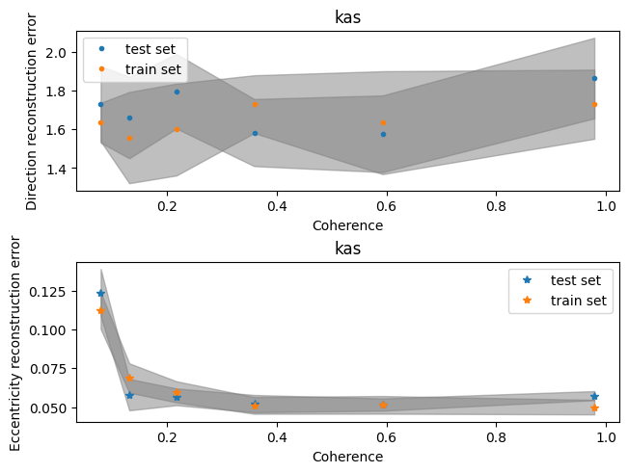
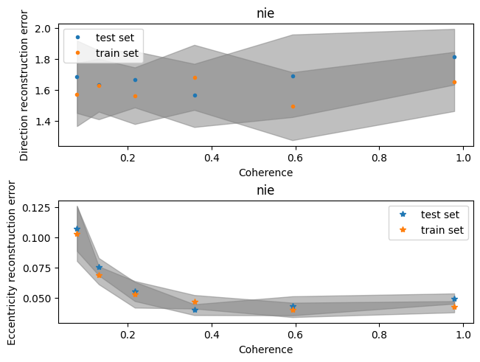
Reconstruction error training set vs test set

Slide 20
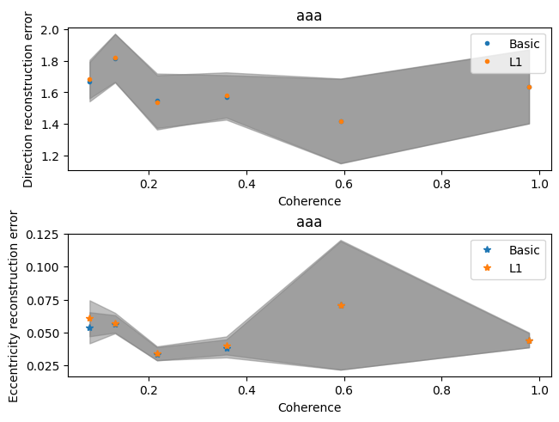
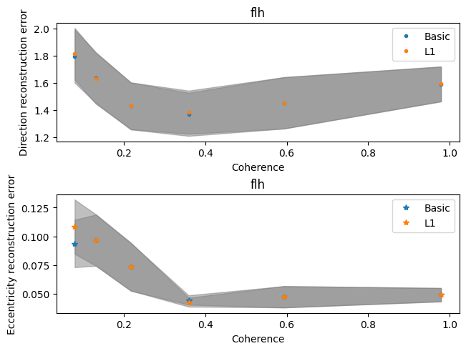
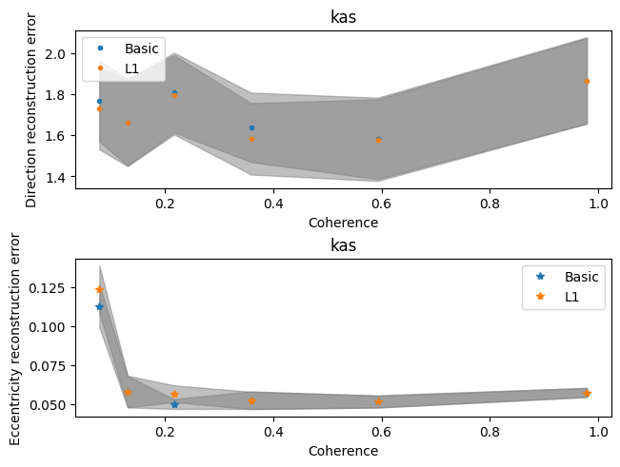
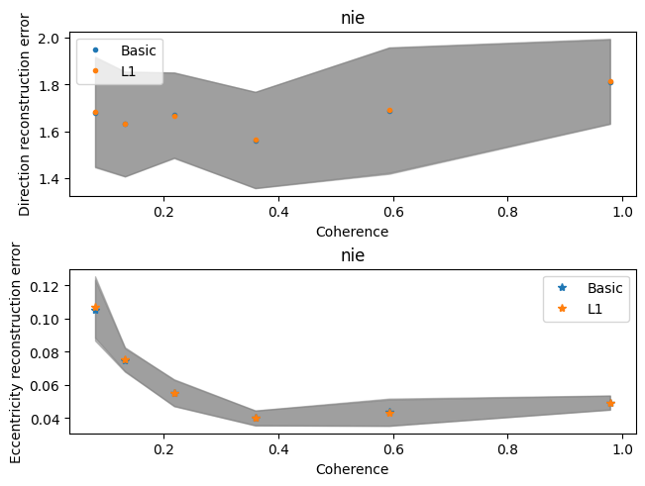
Reconstruction error: basic vs L1 kernel

